Slide 1

Invention/Investment Club
March 28, 2018

Slide 2
Agenda
Jeff Dunbar, Director, Technology Transfer
SUNY Intellectual Property Policy
Technology Transfer Overview
Intro to Business and Entrepreneur Partnerships
Time Permitting: New York State Investment Environment

Slide 3
SUNY Intellectual Property Policy
UB owns if:
Within the scope of the Creator’s employment by SUNY (RF); or
Through the Substantial Use of SUNY Resources, unless otherwise agreed in writing
Inventor Net Royalty Share
45% of first $100,000; 40% thereafter
Release and Waiver
To the inventors (or funding agency) if UB decides not to pursue

Slide 4
SUNY Intellectual Property Policy (cont’d)
Student owns IP if:
A Creator who is a Student and not also Personnel may retain ownership rights to IP Created through no more than Incidental Use of SUNY Resources
Student shall own copyright to thesis unless an agreement supporting the work states otherwise; SUNY shall have an unrestricted royalty-free license to reproduce and disseminate.
Exception: Experiential Learning programs
Copyright Ownership
Generally the Creator, unless
Scope of employment
Subject to contractual arrangement (e.g. sponsored research)

Slide 5
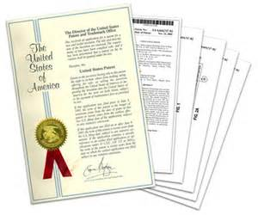
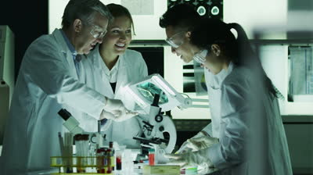

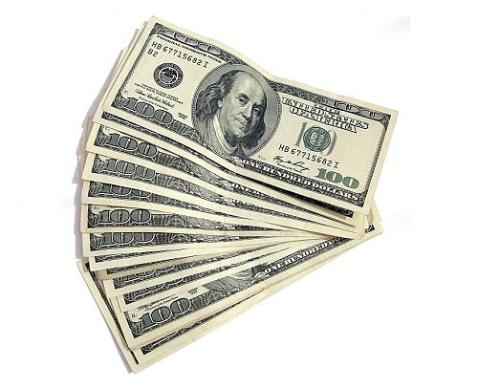

Entrepreneurship: Transferring ideas into enterprises that create value.
Technology transfer: Transferring ideas into enterprises that create value
Technology commercialization
Industry R&D partnerships
VALUE to: Customer
Shareholders
+
Communities (Economic Dev)
INVESTMENT

Slide 6
Paradigm Shift
Pre 1980 (“Broken”)
Funding agencies owned inventions
Lacked university or researcher incentives to participate
Discoveries published before being protected
Companies found it difficult to license from the federal agencies
Bayh-Dole Act (1980)
To improve U.S. global competitiveness
Universities may elect title to inventions made under federal research grants
Inventor share of revenues required (SUNY = 40%)
University revenues to be invested in research and education
Preference for U.S. and small business
Obligations to report and commercialize

Slide 7
Benefit to the Public (AUTM FY 2016)
In FY 2016 (195 institutions reporting)
$66.98 billion total research expenditures
7,021 issued U.S. patents (+5.1%)
7,161 licenses executed (70% to small & startups)
800 new commercial products launched
1,024 start-ups created
73.4% in institution’s home state
U.S. economic impact since 1996: $1.3 trillion US industry gross output; $591 billion US GDP; 4.3 million person years of employment

Slide 8




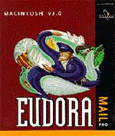
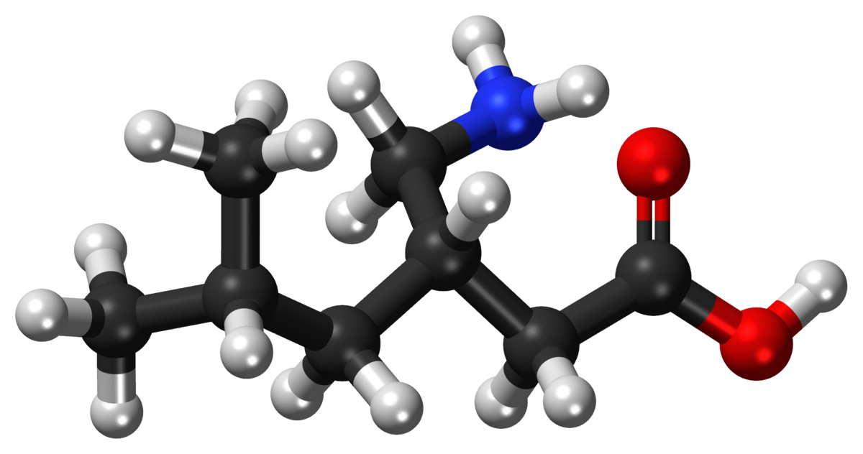
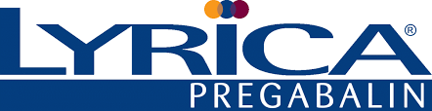

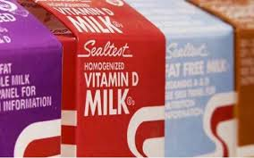
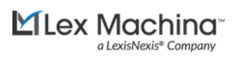

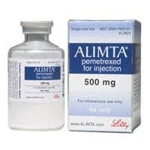

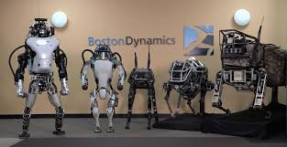
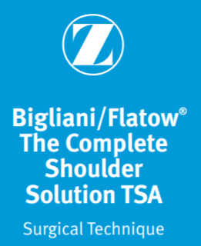
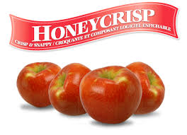


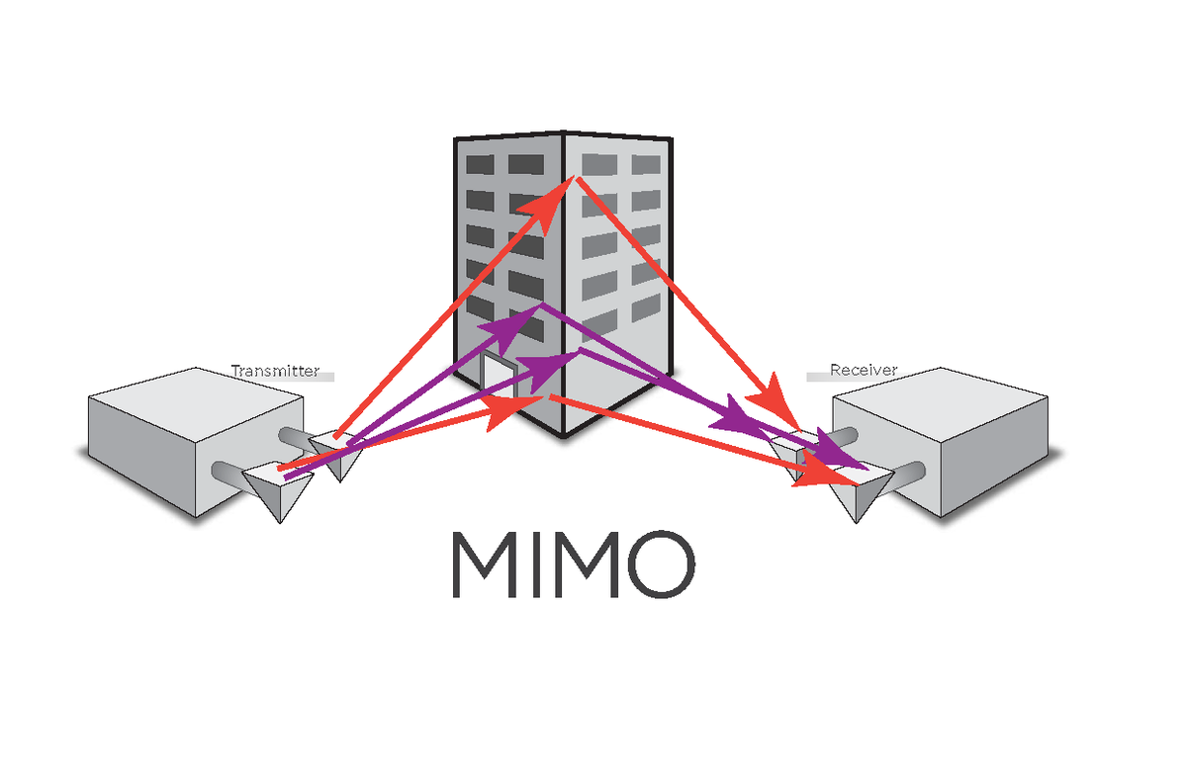

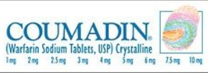







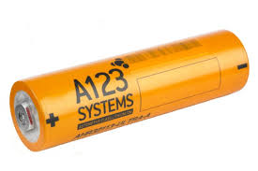

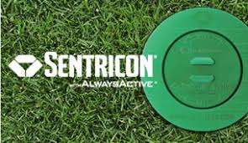

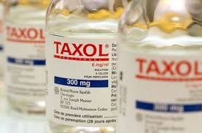

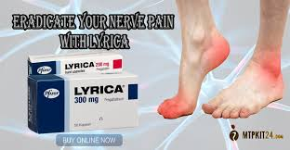
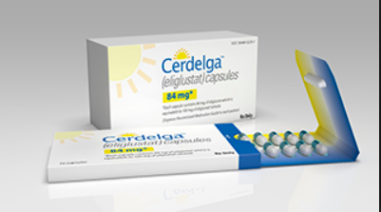
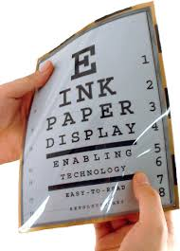
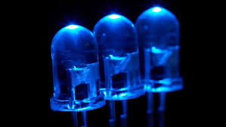
Lifesaving or Life Improving Blockbuster Products or Companies Emerged from University Research
Blue LED

Slide 9
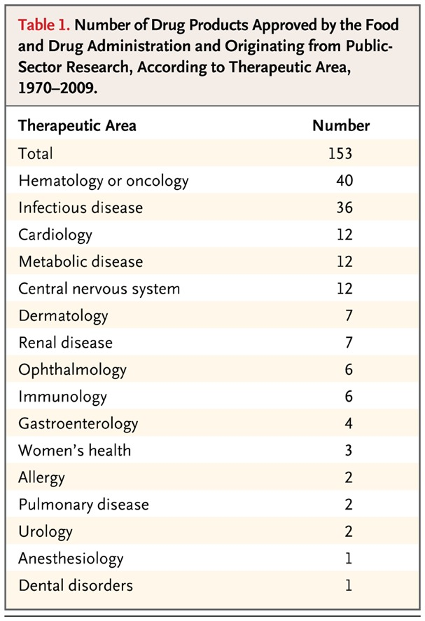
The Role of Public-Sector Research in the Discovery of Drugs and Vaccines Stevens A. et al New England Journal of Medicine N Engl J Med 2011;364:535-41
Period: 1970-2009
153 new FDA-approved drugs, vaccines, or new indications
93 small molecule
36 biologics
15 vaccines
8 in vivo diagnostic materials
1 OTC

Slide 10






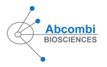












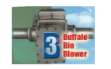
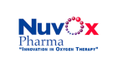
UB License Examples

Slide 11
Intellectual property

Slide 12
Patent-Eligible Subject Matter
35 USC § 101
Machine
Article of Manufacture
Composition
Process
e.g., using or manufacturing
Notes:
How do you translate your invention into a patent?
Like the Nitinol inventors, you should consider whether your invention falls into one of the statutory categories.
It must be…
What if your invention does not fit in these categories?
Consider whether you can apply your invention to one of the these categories.
- Disease mechanism
- New compound using that mechanism to treat the disease

Slide 13
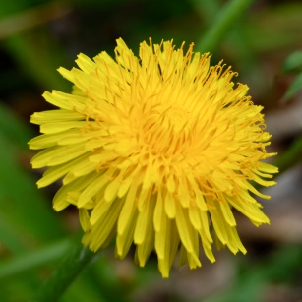
Judicially Ineligible Subject Matter
Abstract ideas
Algorithms
Laws of nature
Natural phenomena
GRAVITY
Notes:
Once you have an invention, do you follow the maxim of publish or perish?
Not yet. In patent law, you must

Slide 14
Patent Rights
35 USC § 154: grants inventor the right to exclude others from…
Making
Using
Selling
Offering to sell, or
Importing
…the patented subject matter and from importing the product of a patented process

Slide 15
Basic Patent Requirements
Novelty
Fail to meet if a single reference describes all elements of the invention
Non-Obviousness
Fail to meet if two or more references, when considered together, would make the invention obvious to a person with ordinary skill in the art
Utility
Generally considered met
Written Description
Enables a person with ordinary skill in the art to practice the invention
In return for 20 year patent life

Slide 16
Assessment – Graphene Tech
Disclosed invention | Inoue et al (www.electrochem.org/meetings/scheduler/abstracts/214/0462.pdf) | Li and Kaner Science 30 May 2008, 320, 1170-1171 | Chhowalla Nature Nano 2008, 3, 270-274 | Yang, Kaner Nature Nano 2009, 4, 25-29 | Sidorov Nanotechnology 2007, 18 | Liu Advanced Functional Materials 2008, 18, 1518-1525
Graphite → graphite oxide via chemical oxidation/Hummer’s method | √ |  | √ | √
Graphite oxide → graphene oxide via exfoliation (thermal, mechanochemical or ultrasonication) | √ | √ | √ | √
Electrophoretic deposition of graphene oxide onto substrate (ITO coated glass slide) |  | Graphene films made by drop casting, spraying, electrostatic adsorption, filtration, dip- or spin-coating |  | Coatings, via spin-coating, | Electrostatic deposition of graphene | Ionic-liquid-assisted electrochemical synthesis of graphene nanosheets
Reduction via hydrazine | √ | √ | √ | √
Notes:
Filed patent and licensed to start-up.

Slide 17

Perceived strength
Strong
Composition of Matter
and Devices
Covered regardless of how it is used
Easy to design around
May be difficult to “police”
Methods and Processes
Weak

Slide 18
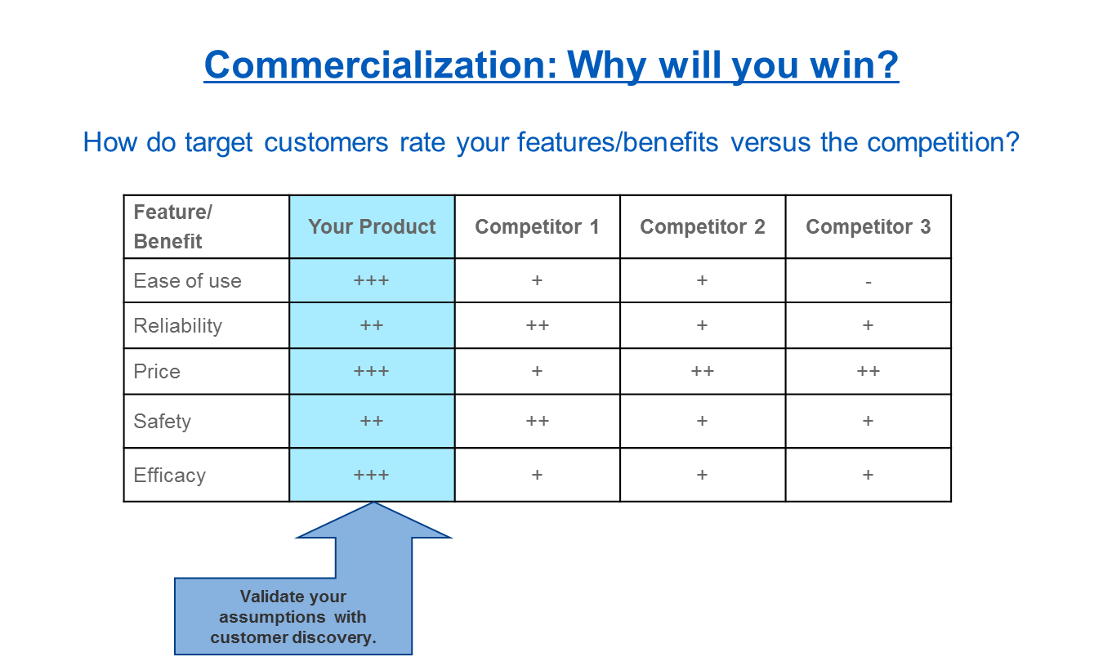

Slide 19
Business and Entrepreneur Partnerships

Slide 20
BEP Industry Engagement Startup Programs Lecture Series and special events (Bright) Proof Of Concept Funds I-CORPS SBIR/STTR support Incubators and other facilities Western NY Incubator Network (WIN) STARTUP NY Center for Advanced Technology: Big Data and Health Sciences (CAT) Center for Material Informatics (CMI) Buffalo Institute of Genomics (BIG) Center For Computational Research (CCR)
School of Management
Blackstone LaunchPad
Panasci TEC

Slide 21

Example
UB I-Corps Site:
$500k National Science Foundation funding over five years to support the commercialization of research discoveries.
30 teams a year (3X10) - ~3K per team, National conference
Criteria: NSF Mission compatible; IP; UB connection; Large opportunity; team commitment
National Node Program Opportunity – $50K, 7 weeks,
Notes:
We are already making significant progress on implementing this strategy:
We have 3 major new federal/state funded tech commercialization initiatives underway:
I-Corps, an Innovation Hub & a drug discovery center.
I-Corps: Technologies are now more customer facing & market-driven. Innovation Teams that have completed I-Corps will have better understanding of customer needs and market demands, and be better equipped to complete a formal business model. While some teams will “fail fast”, 5-10 teams annually will move on to the national I-Corps program and/or receive SBIR/STTR funding
List faculty participating in upcoming I-Corps
Company/Student & Faculty
AdMo/Sekhar Rajendran – Research Assistant, (PhD student) UB Electrical Engineering/Dr. Zhi Sun – Assistant Professor UB EE & Advisor
Advance Surgical Solutions/Jay Kapadia – Student, UB Advanced Manufacturing/Ravi Kapadia
Bariatric Outcomes – Self-management for Sustained Surgical Success (BOSSSS) Inc./Laura Anderson – Assistant Professor & Licensed Psychologist, UB Nursing
Channavix/Elsa Daurignac – Research Assistant Professor, UB Psychiatry/Arin Bhattacharjee – Associate Professor, UB Pharmacology & Toxicology
Cold Space/Elijah Tyson – student/Abidul Alam – student
CRO – Gene Silencing Agents for Eye/Jack Sullivan – Professor, UB Opthalmology/Mark Butler – Senior Research Support Specialist, UB Opthamology
Energy Harvesting for Pacemakers/Amin Karami – Assistant Professor, UB Mechanical & Aerospace Engineering/Hooman Ansari – PhD Candidate, UB Mechanical & Aerospace Engineering
FunctionOMICS/Irwin Gelman – Distinguished Proffesor of Oncology, Roswell Park Cancer Institute/Henry Withers – Graduate Research Fellow, RPCI
Storillo/Thomas Wilike – UB student/Tim Adowski – UB student
Sunny Clear Water/Haromin Song – Research Associate – UB Electrical Engineering/Nan Zhang – Research Assistant, UB Electrical Engineering

Slide 22
New York State Investing Environment

Slide 23
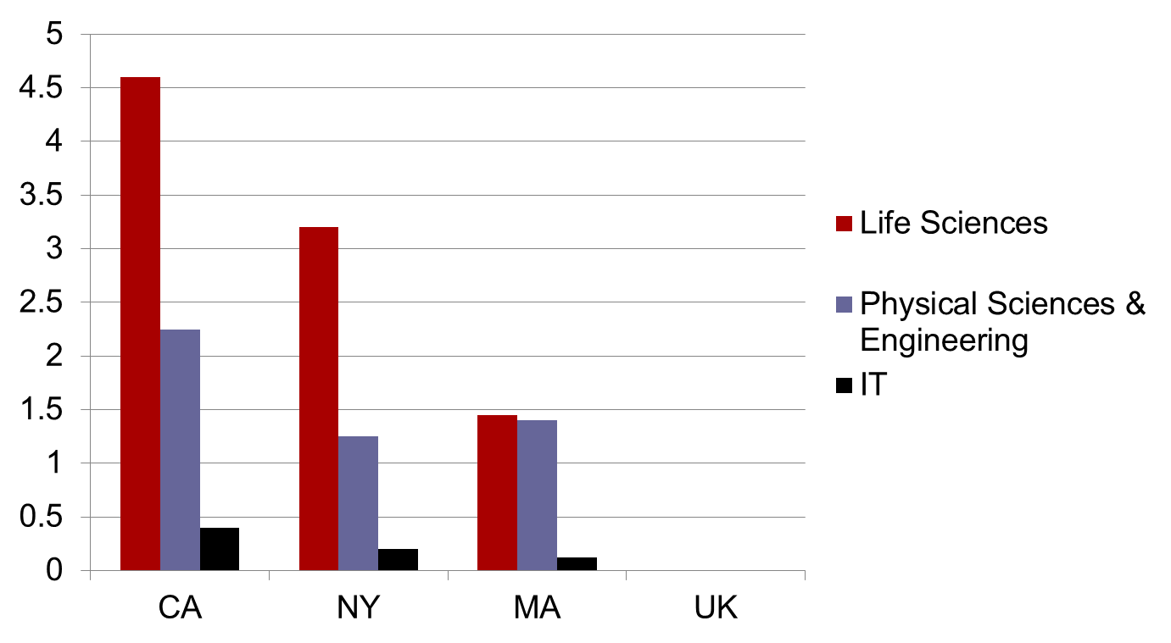
NY Universities Second in research investment in USA

Slide 24
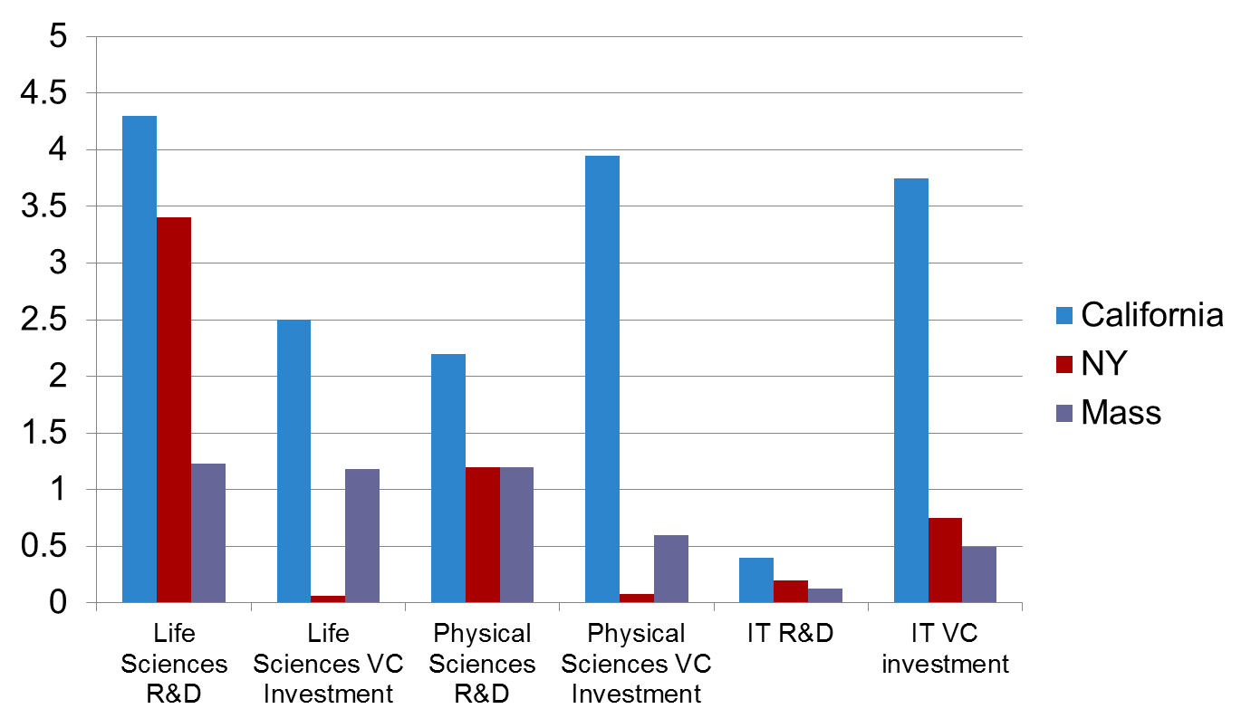
NY vs. CA and MA
VC funding in NY is far less relative to R&D funding than CA and MA
CA and MA do more startups in biotechnology and engineering
Funding deficit
Funding deficit
Billions of dollars

Slide 25
Thank you

